Slide 1



Slide 2
About the Project
This project focuses on analyzing sales data for Cookd, a retail business, to uncover key insights and drive data-informed decisions. Leveraging Python for data cleaning, preprocessing, and analysis, the dataset of 100,000 records was explored to extract meaningful patterns and trends. The analysis covered customer demographics, product performance, regional sales, delivery efficiency, and marketing effectiveness. Key metrics such as total sales, top-performing products, order trends, and customer feedback ratings were evaluated to provide actionable insights. The findings aim to optimize sales strategies, enhance operational efficiency, and improve customer satisfaction.

Slide 3
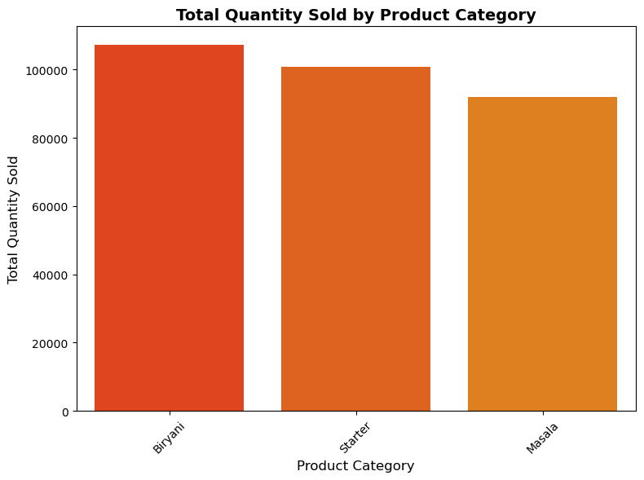
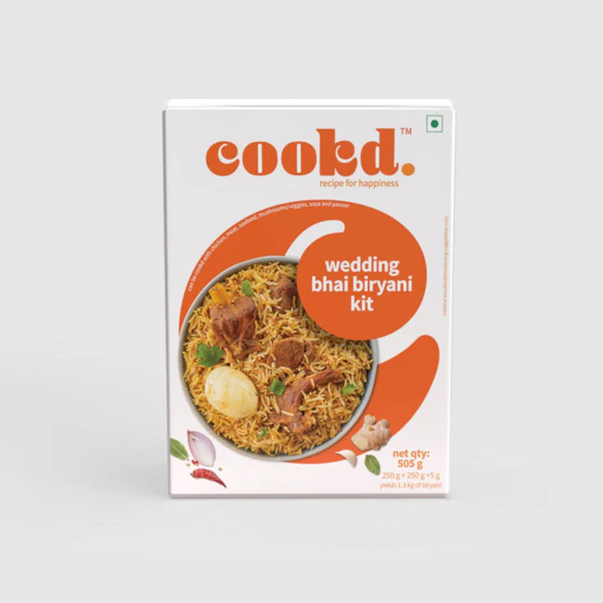
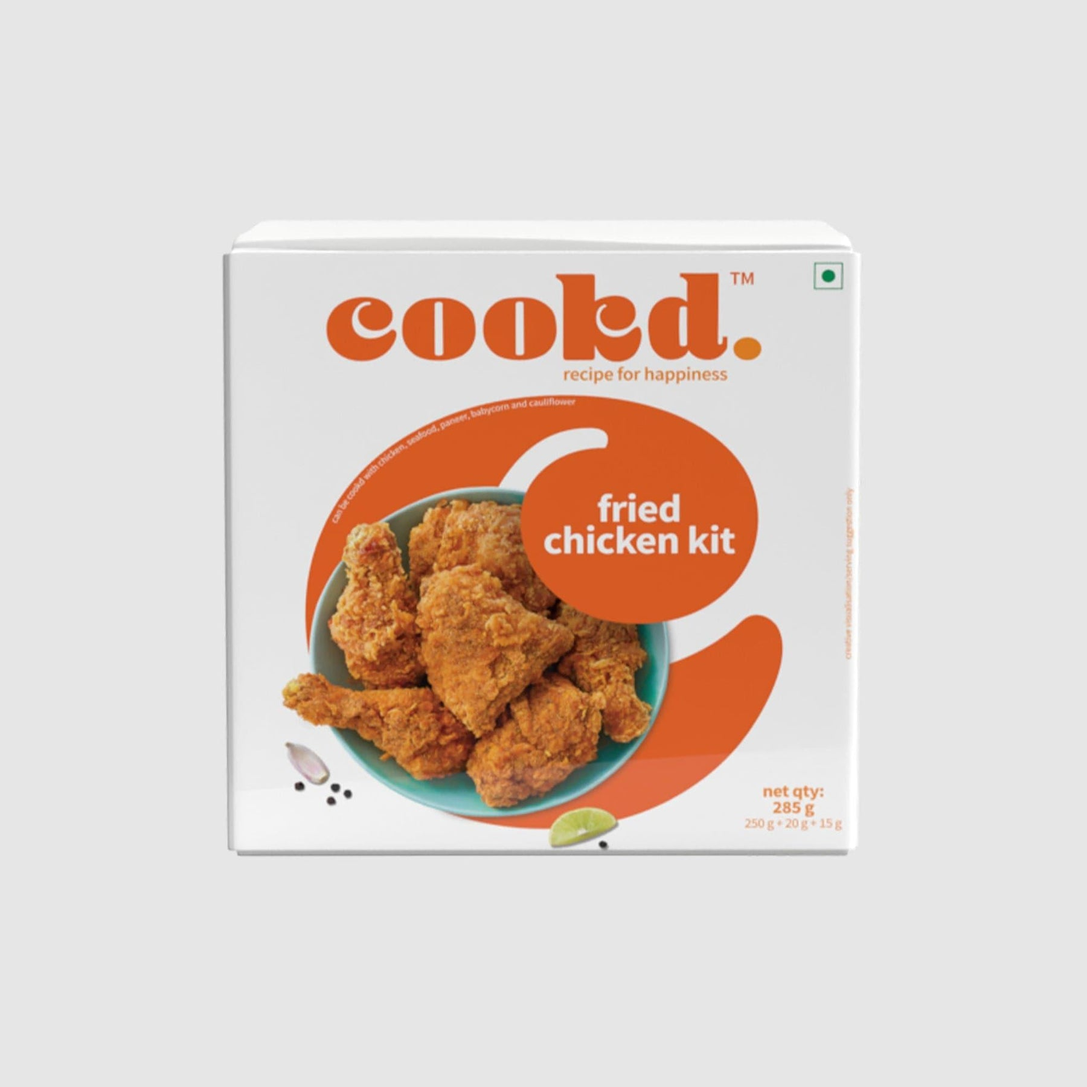
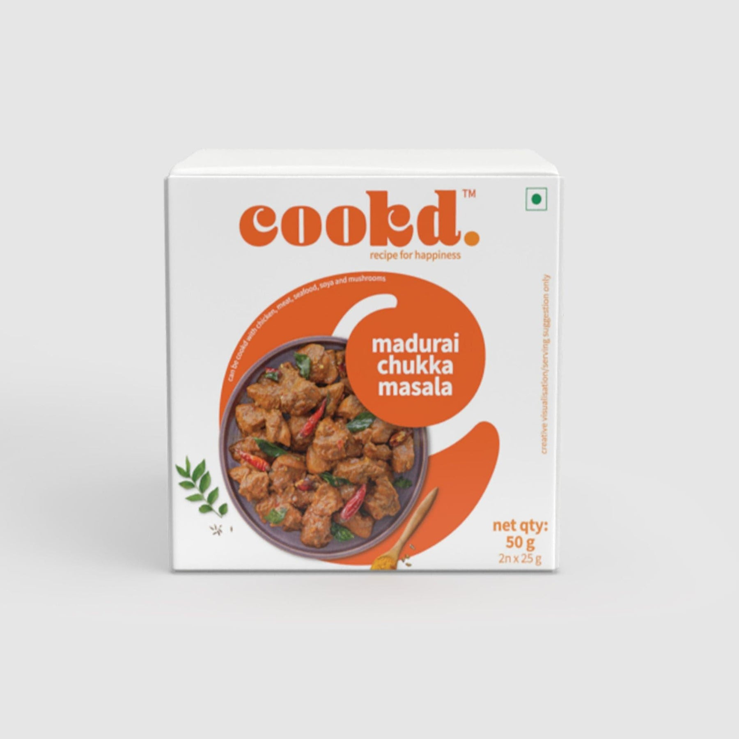
Which product categories generate the most sales?
Biryani emerges as the top-selling category, followed by Starter and Masala. This data highlights the strong customer demand for these items and informs our inventory management, promotional strategies, and future product development plans.

Slide 4
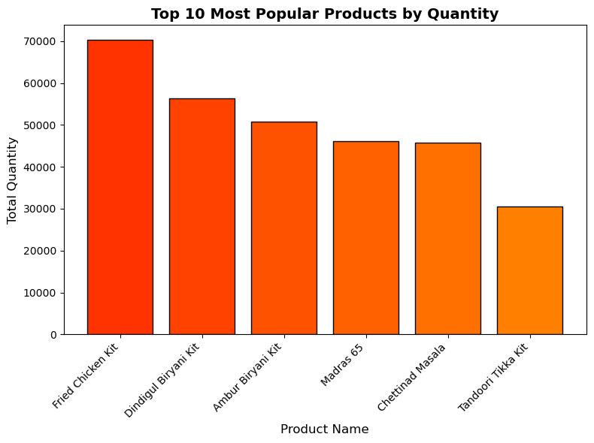
Top 10 Most Popular Products
Fried Chicken Kit emerges as the most popular product, followed closely by Dindigul and Ambur Biryani Kits. To capitalize on this, we will prioritize inventory levels for these top-selling products and explore targeted promotions to further boost their popularity. We will also analyze the performance of lower-ranking products to identify opportunities for improvement.

Slide 5
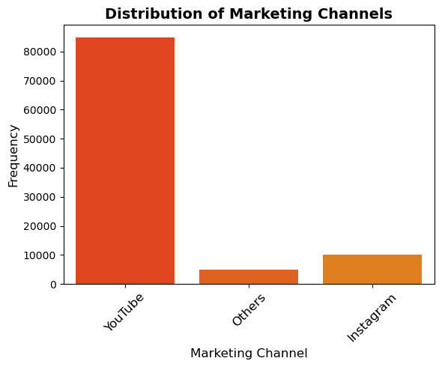
Which marketing channel drives the highest customer engagement
YouTube stands out as the most influential marketing channel, followed by Instagram and a smaller segment of 'Others.' This data highlights the importance of maximizing our YouTube presence while strategically leveraging Instagram to reach our target audience.

Slide 6
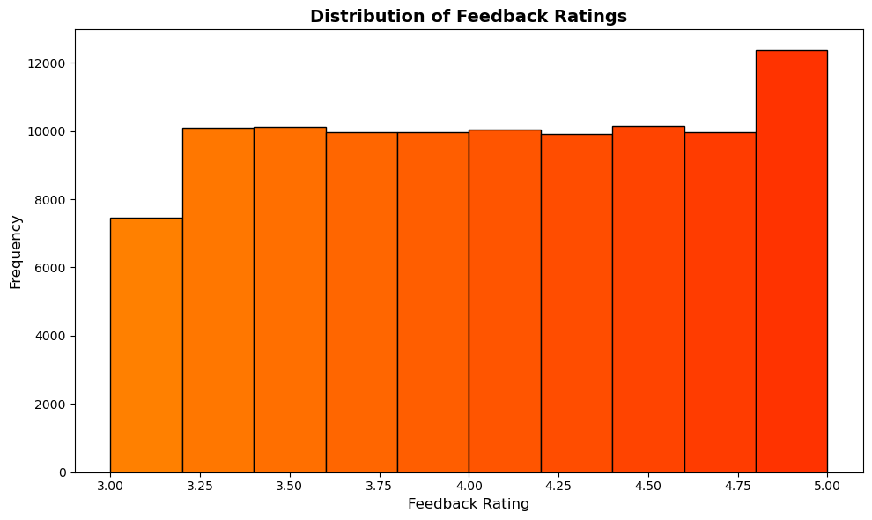
distribution of feedback ratings
The feedback ratings are concentrated between 3.5 and 4.5, suggesting a positive customer experience. A smaller portion of ratings fall below 3.5 or exceed 4.5. This data provides valuable insights for optimizing product/service offerings and enhancing customer satisfaction.

Slide 7
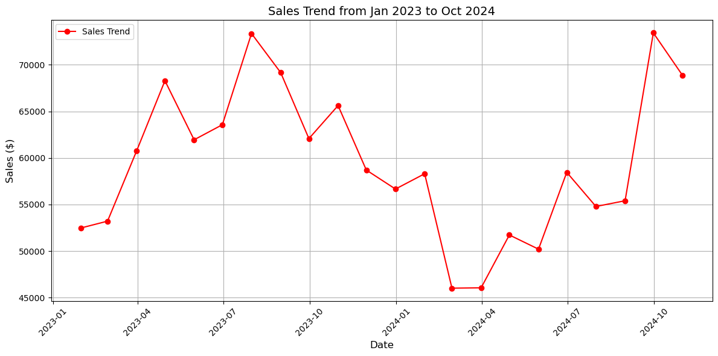
Sales Trend Analysis
Sales have fluctuated from January 2023 to October 2024. This analysis reveals a lack of a consistent trend, emphasizing the importance of understanding seasonal patterns and identifying strategies to improve overall sales performance.

Slide 8
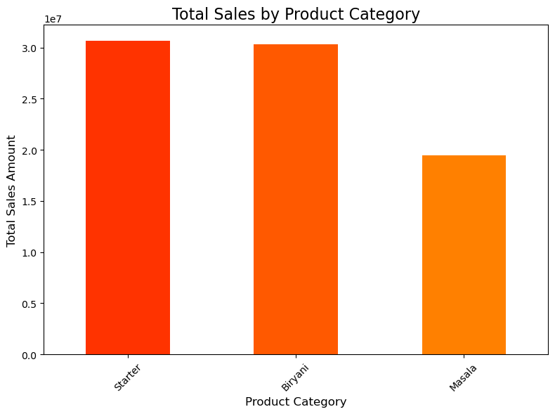
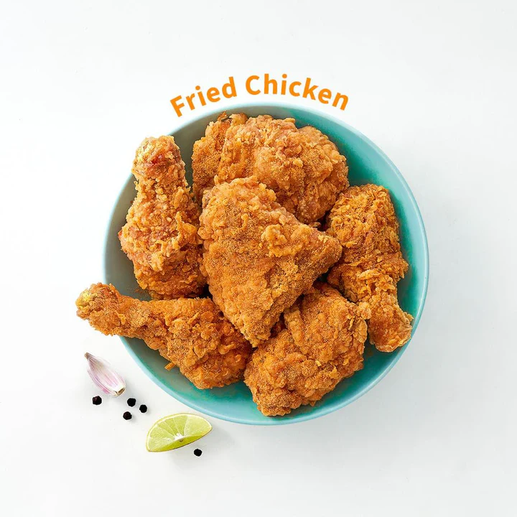
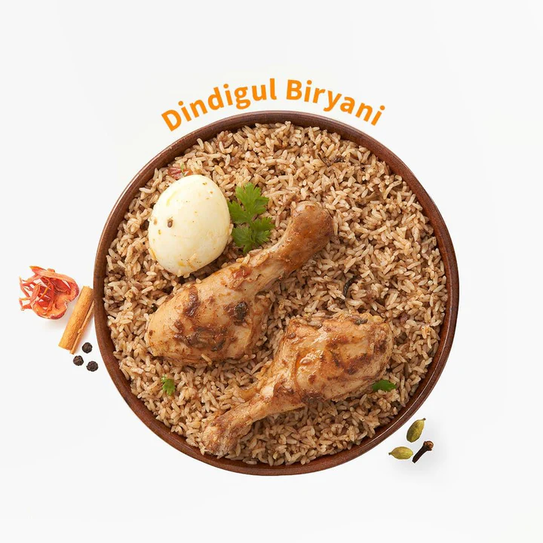
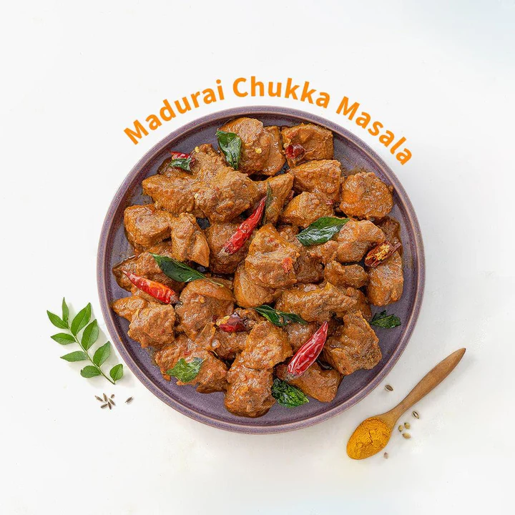
Which product categories generate the most sales?
Starter and Biryani emerge as the product categories generating the highest sales revenue, while Masala lags behind. To capitalize on this, we will prioritize the development of new and exciting Starter and Biryani options, while exploring strategies to enhance the appeal and sales of Masala products.

Slide 9
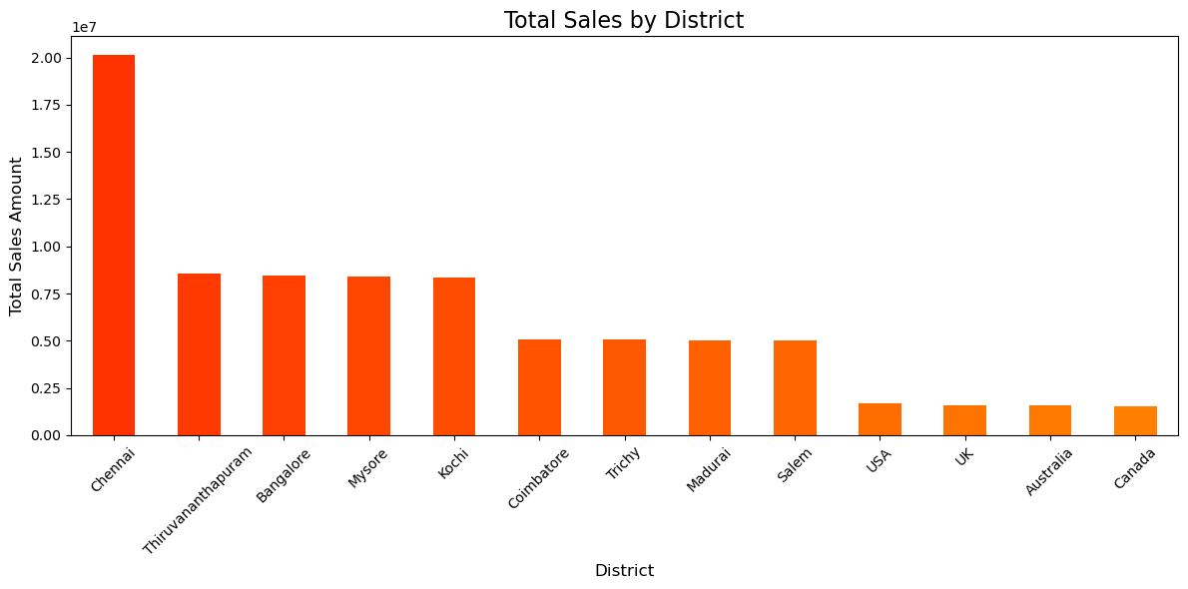
Which districts generate the highest sales?
Chennai emerges as the top-performing district, with Kochi, Mysore, Thiruvananthapuram, and Bangalore following closely. To maximize sales potential, we should prioritize resource allocation and marketing efforts in these districts while exploring strategies to boost sales in the remaining regions.

Slide 10
